Slide 1
Fantasy Quest
A Pitch Deck by Joshua Evans 22153027

Slide 2

Who Am I?
I’m Joshua Evans. A 3rd year student at BCU on a Computer Games Technology with a minimum of 2 years' experience developing games on a smaller/university project scale. With experience in Unreal Engine and Unity and both C# and C++ with additional experience in server backend development during a stint in Web Game development

Slide 3

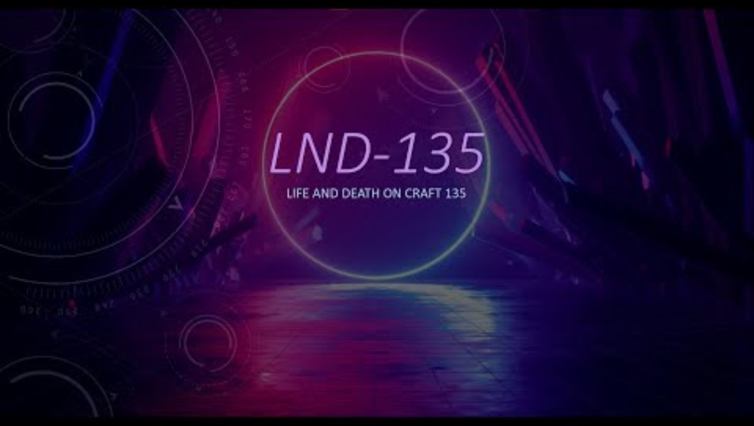
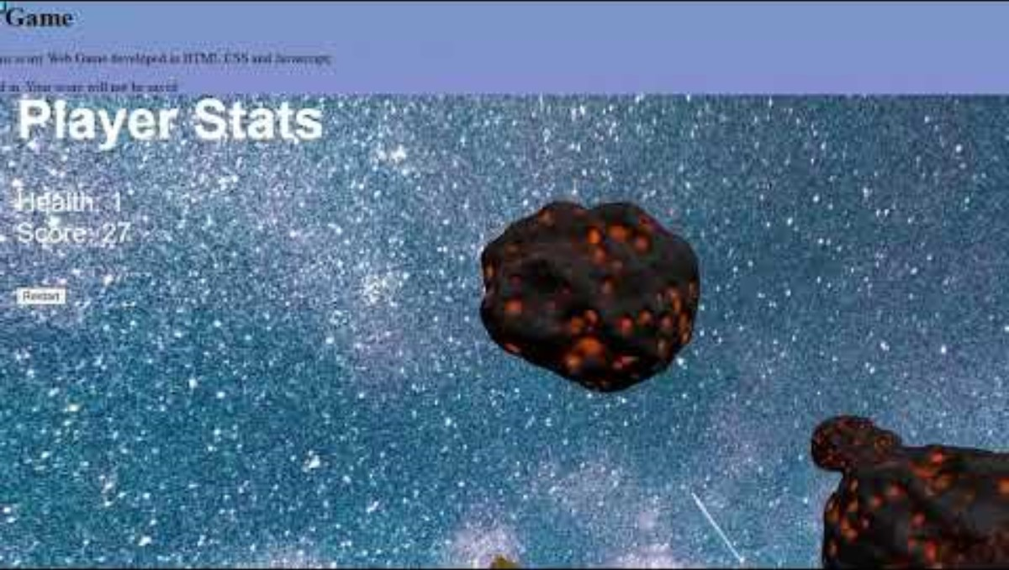
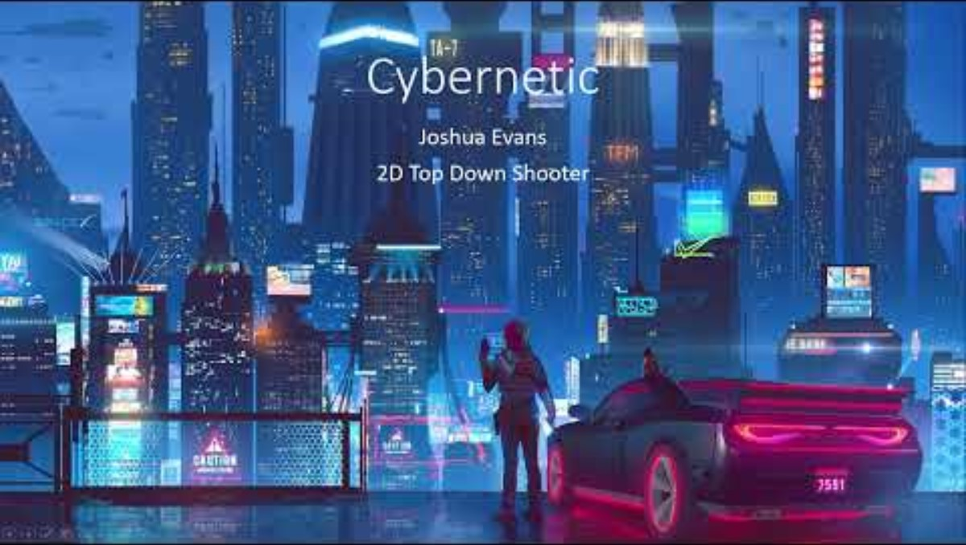
Past Projects
Group Project
I worked on the UI Design
Developed in UE5
Made use of coding standards
Web Game developed in (HTML, CSS and JavaScript)
Made use of server backends like SQL and using cookies in browser
Programmed in C++
Using External Libraries like SDL2

Slide 4
Gameplay Premise
Fantasy Quest is a Turn Based RPG inspired by the likes of early Final Fantasy games but instead will be built primarily for a mobile games' audience from the beginning instead of being a ported console game. This will allow for a rather robustly built UI and the integration of modern monetisation strategies.
This project aims to take cues from other mobile games when it comes to UI design to create a intuitive UI that also suits the Fantasy setting of the game.
The game is designed to be hyper casual with little amounts of complex strategies with it primarily being intended to scratch a power fantasy itch in the players head seeing bigger and bigger numbers appear for their attacks and stats.

Slide 5
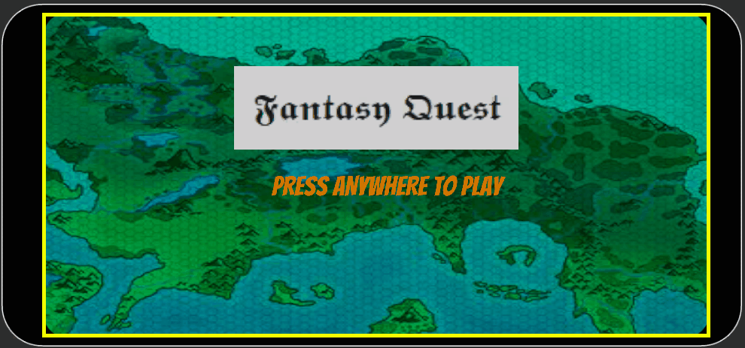
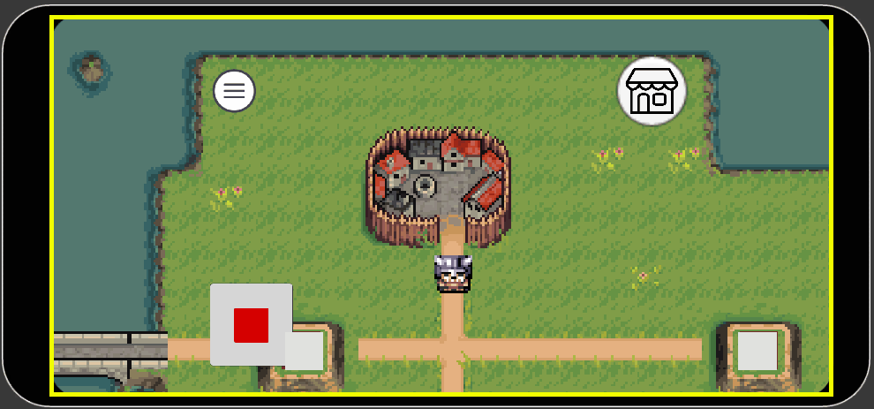
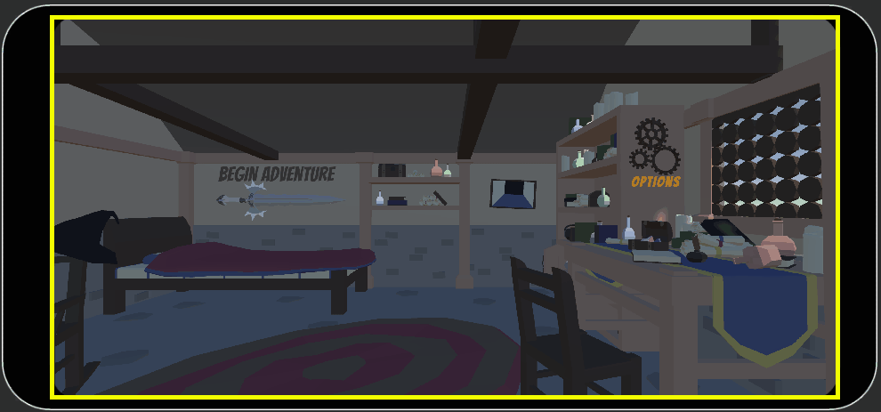
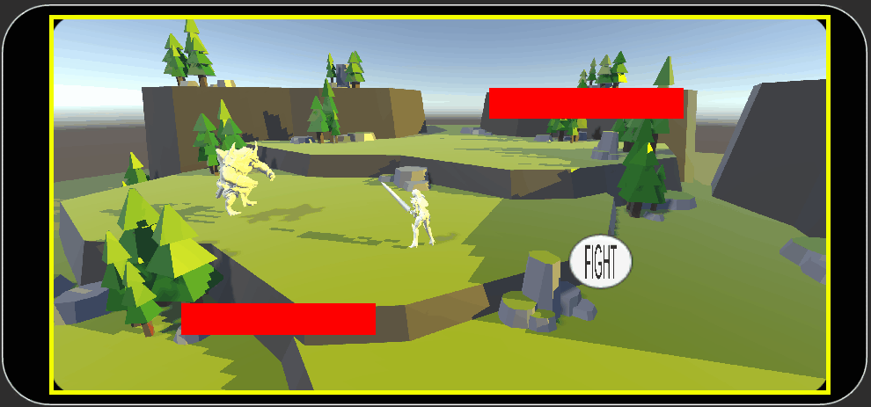
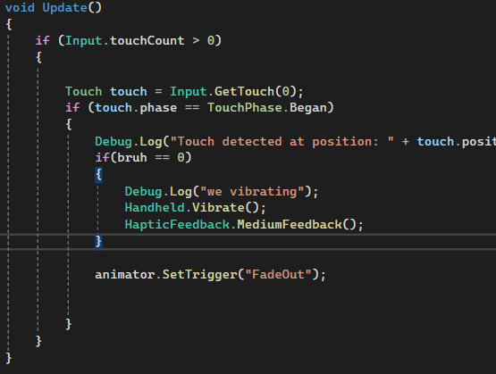
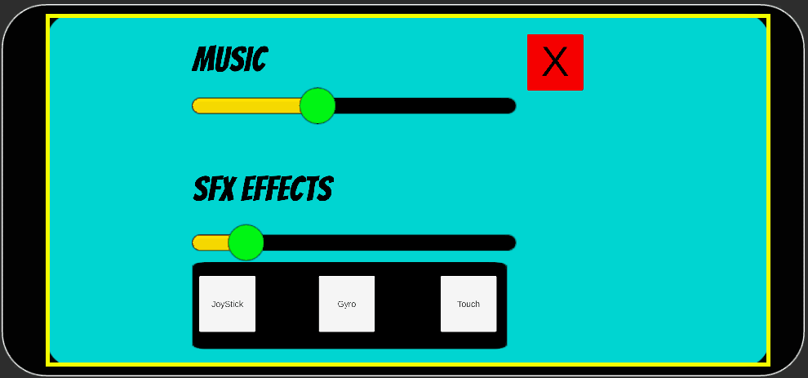
Gameplay Features
Options Menu with Data Persistence between sessions
Basic Touch Detection
Gyro and Joystick Controls
Rudimentary Turn Based Combat
Vibrations
UI Scales Between Devices

Slide 6
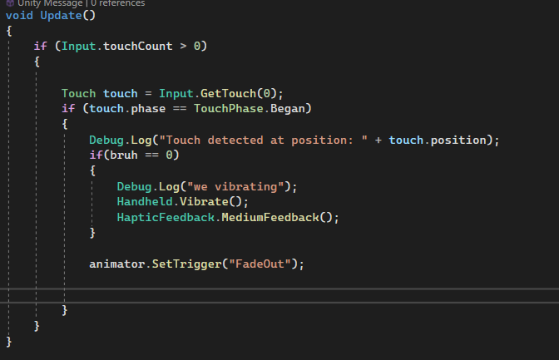
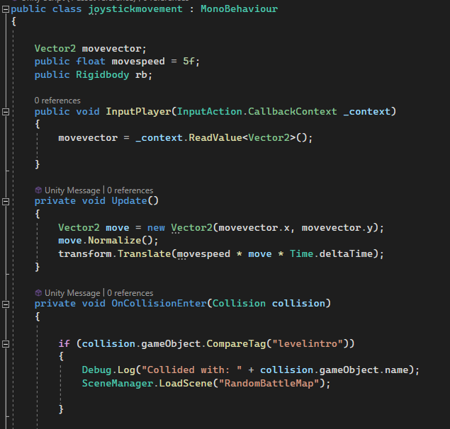
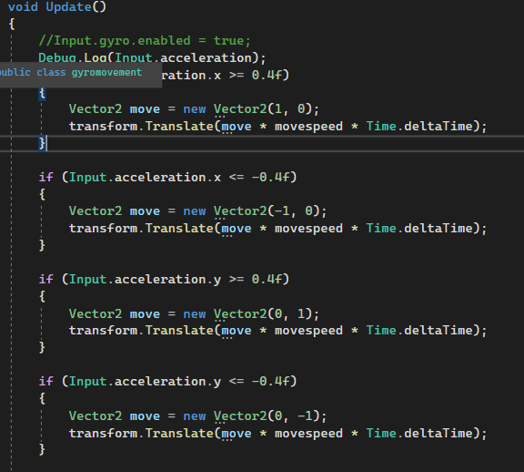
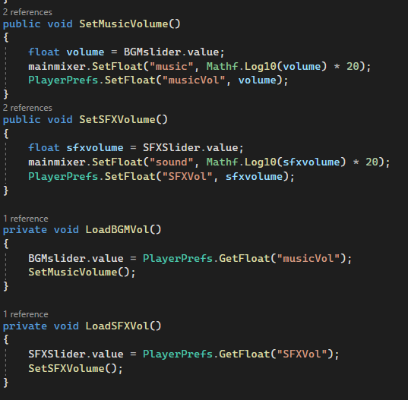
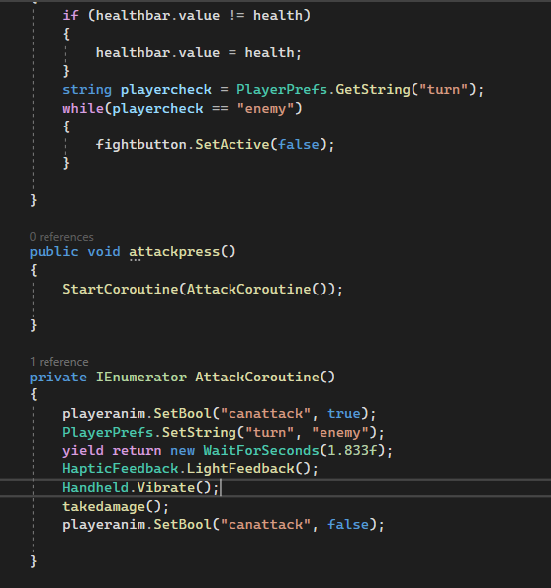
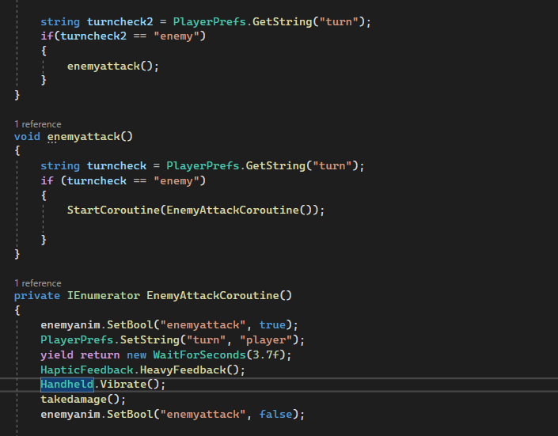
Code Snippets
Options Menu with Data Persistence between sessions
Basic Touch Detection
Gyro and Joystick Controls
Rudimentary Turn Based Combat
Vibrations

Slide 7
Market Research (Part 1)
Target Platform Android – According to iPhone vs Android User Stats (2024 Data) Android globally remains the OS with the most market share and thus also has the most users. Android also has the most apps rated around 4.5-5.0 stars which shows just how active the platform is but also perhaps how saturated the market has become
Turn Based RPG – After a global survey Top global mobile gaming genres 2023 | Statista RPGs only made up around 25% of the respondents however if one becomes rather successful the revenue can be very high. In a very extreme example Fate Grand Order grossed $7 Billion in revenue Fate/Grand Order hits $7 billion in revenue, with Japan accounting for over 80% of total player spending | Game World Observer
Age Rating 12+ – Fantasy as a genre is very wide its’ reach. Games like Final Fantasy Mobile and Fate Grand Order have a 12-rating meaning that while they are still very easy to get into for children, they can tap into some deeper subject matter that younger years may not be able to understand. U.S. weekly mobile gamers by age group 2024 | Statista Additionally a large majority of mobile gamers populate the 18-24 age range, but it would be best for advertising to aim for a lower demographic to catch them while creating a game that appeals to the causal interests of those older

Slide 8
Platform Exclusive Features
Push Notifications (can be useful to keep player engagement over days at a time
In Game Purchase (can be in the form of direct purchases or AdSense)
GPS
Microphones and varies other input methods (Touch, Gyro)
Access to variety of API’s that can utilise unique features

Slide 9
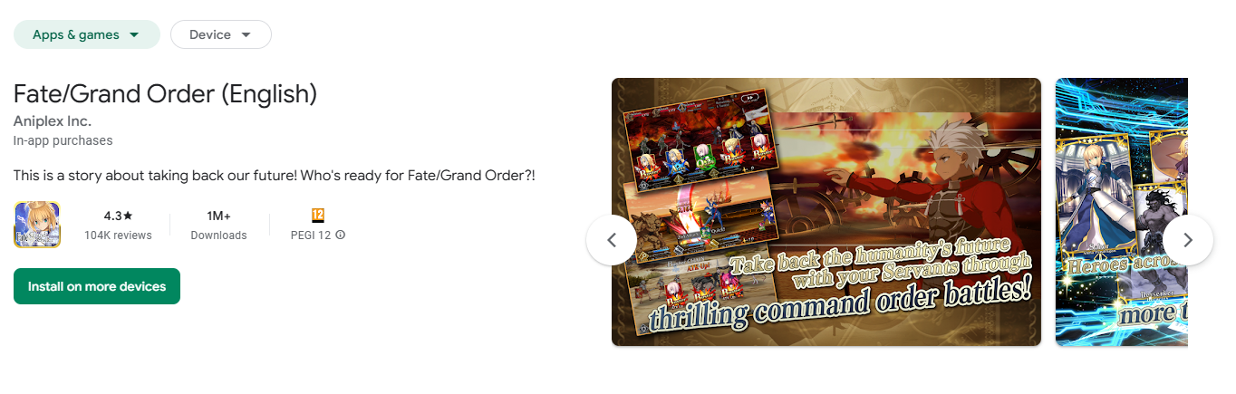
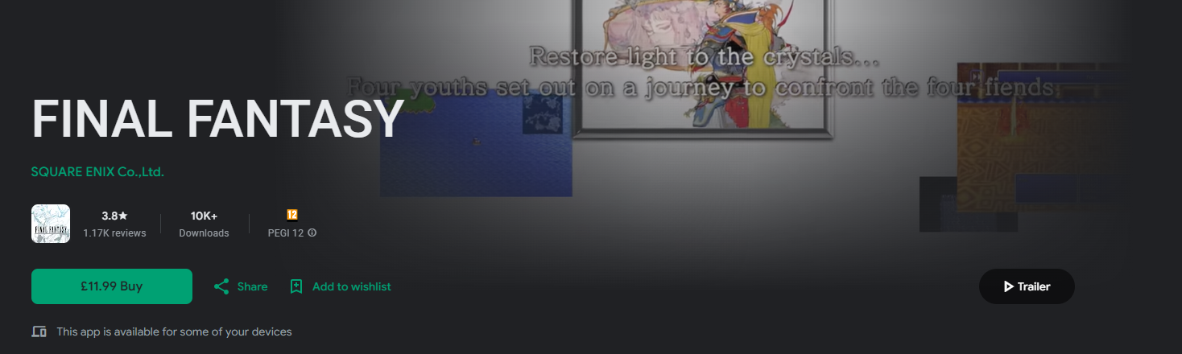
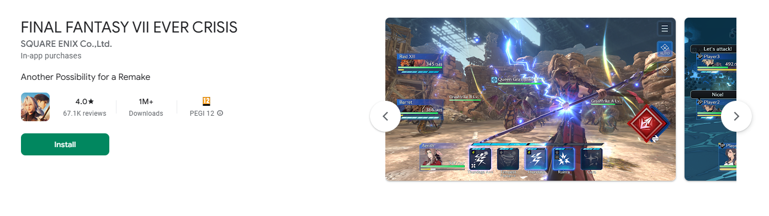
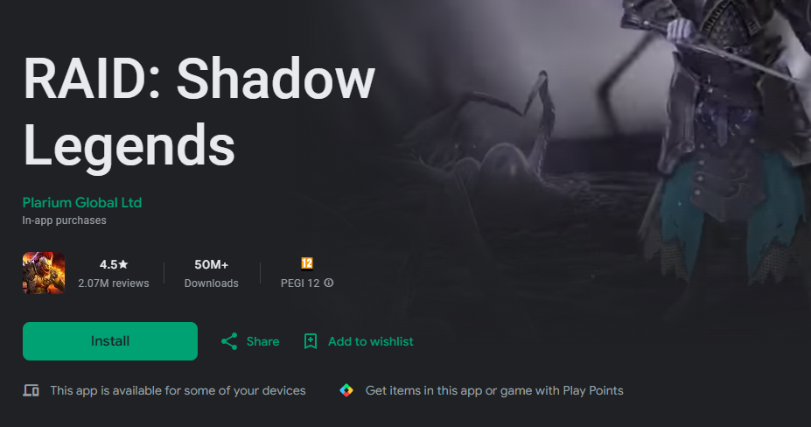
Market Research (Games)
Fate Grand Order
Gacha Game
Turn Based Combat
Extremely Casual
Encourages frequent purchases
Final Fantasy
Turn Based Combat
Console/PC Ported to Mobile
One Time Purchase no microtransaction
Final Fantasy Ever Crisis
Free to play
Gacha Game Mechanics
Built specifically for mobile
Intuitive UI
Raid Shadow Legends
Hyper Casual
Extremely Pay to Win
Turn Based
Lots of microtransactions

Slide 10
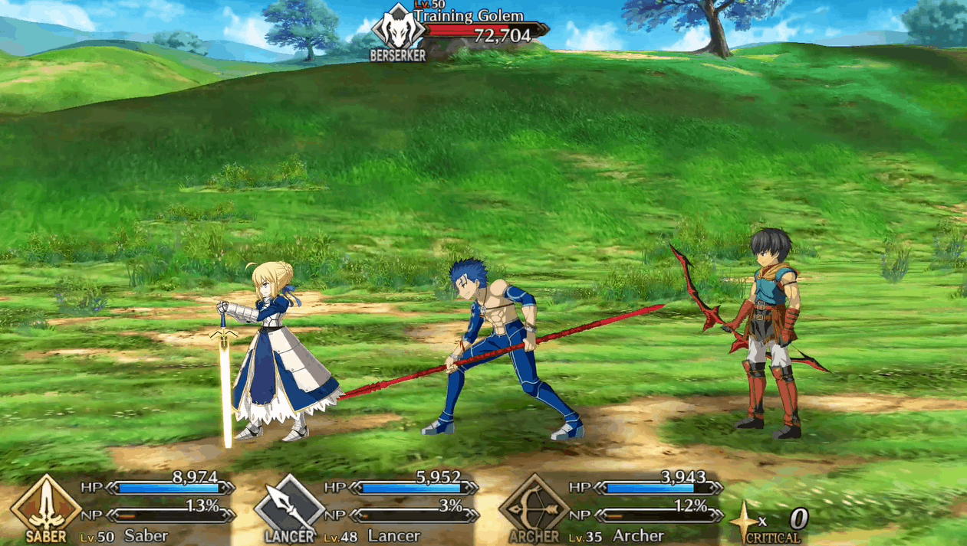
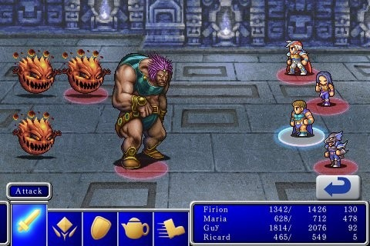
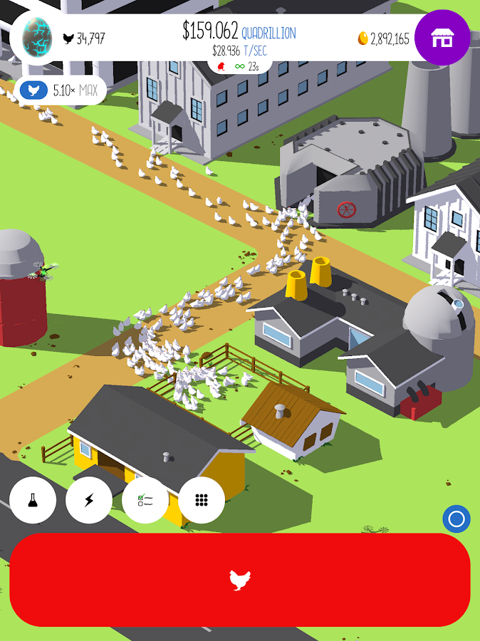

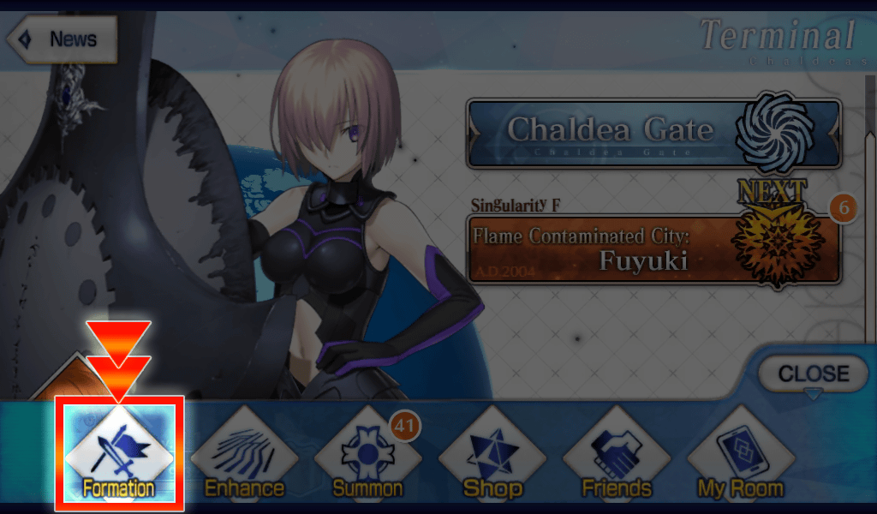
UI Design Considerations
The dynamic format of the battle UI creates a seamless and intuitive experience
Buttons are clunky, take up a lot of space (especially since this example is on an I Touch
All menus are laid out within reach and each have a distinct visual to distinguish them
The menu can dynamically shift depending on the players preference

Slide 11
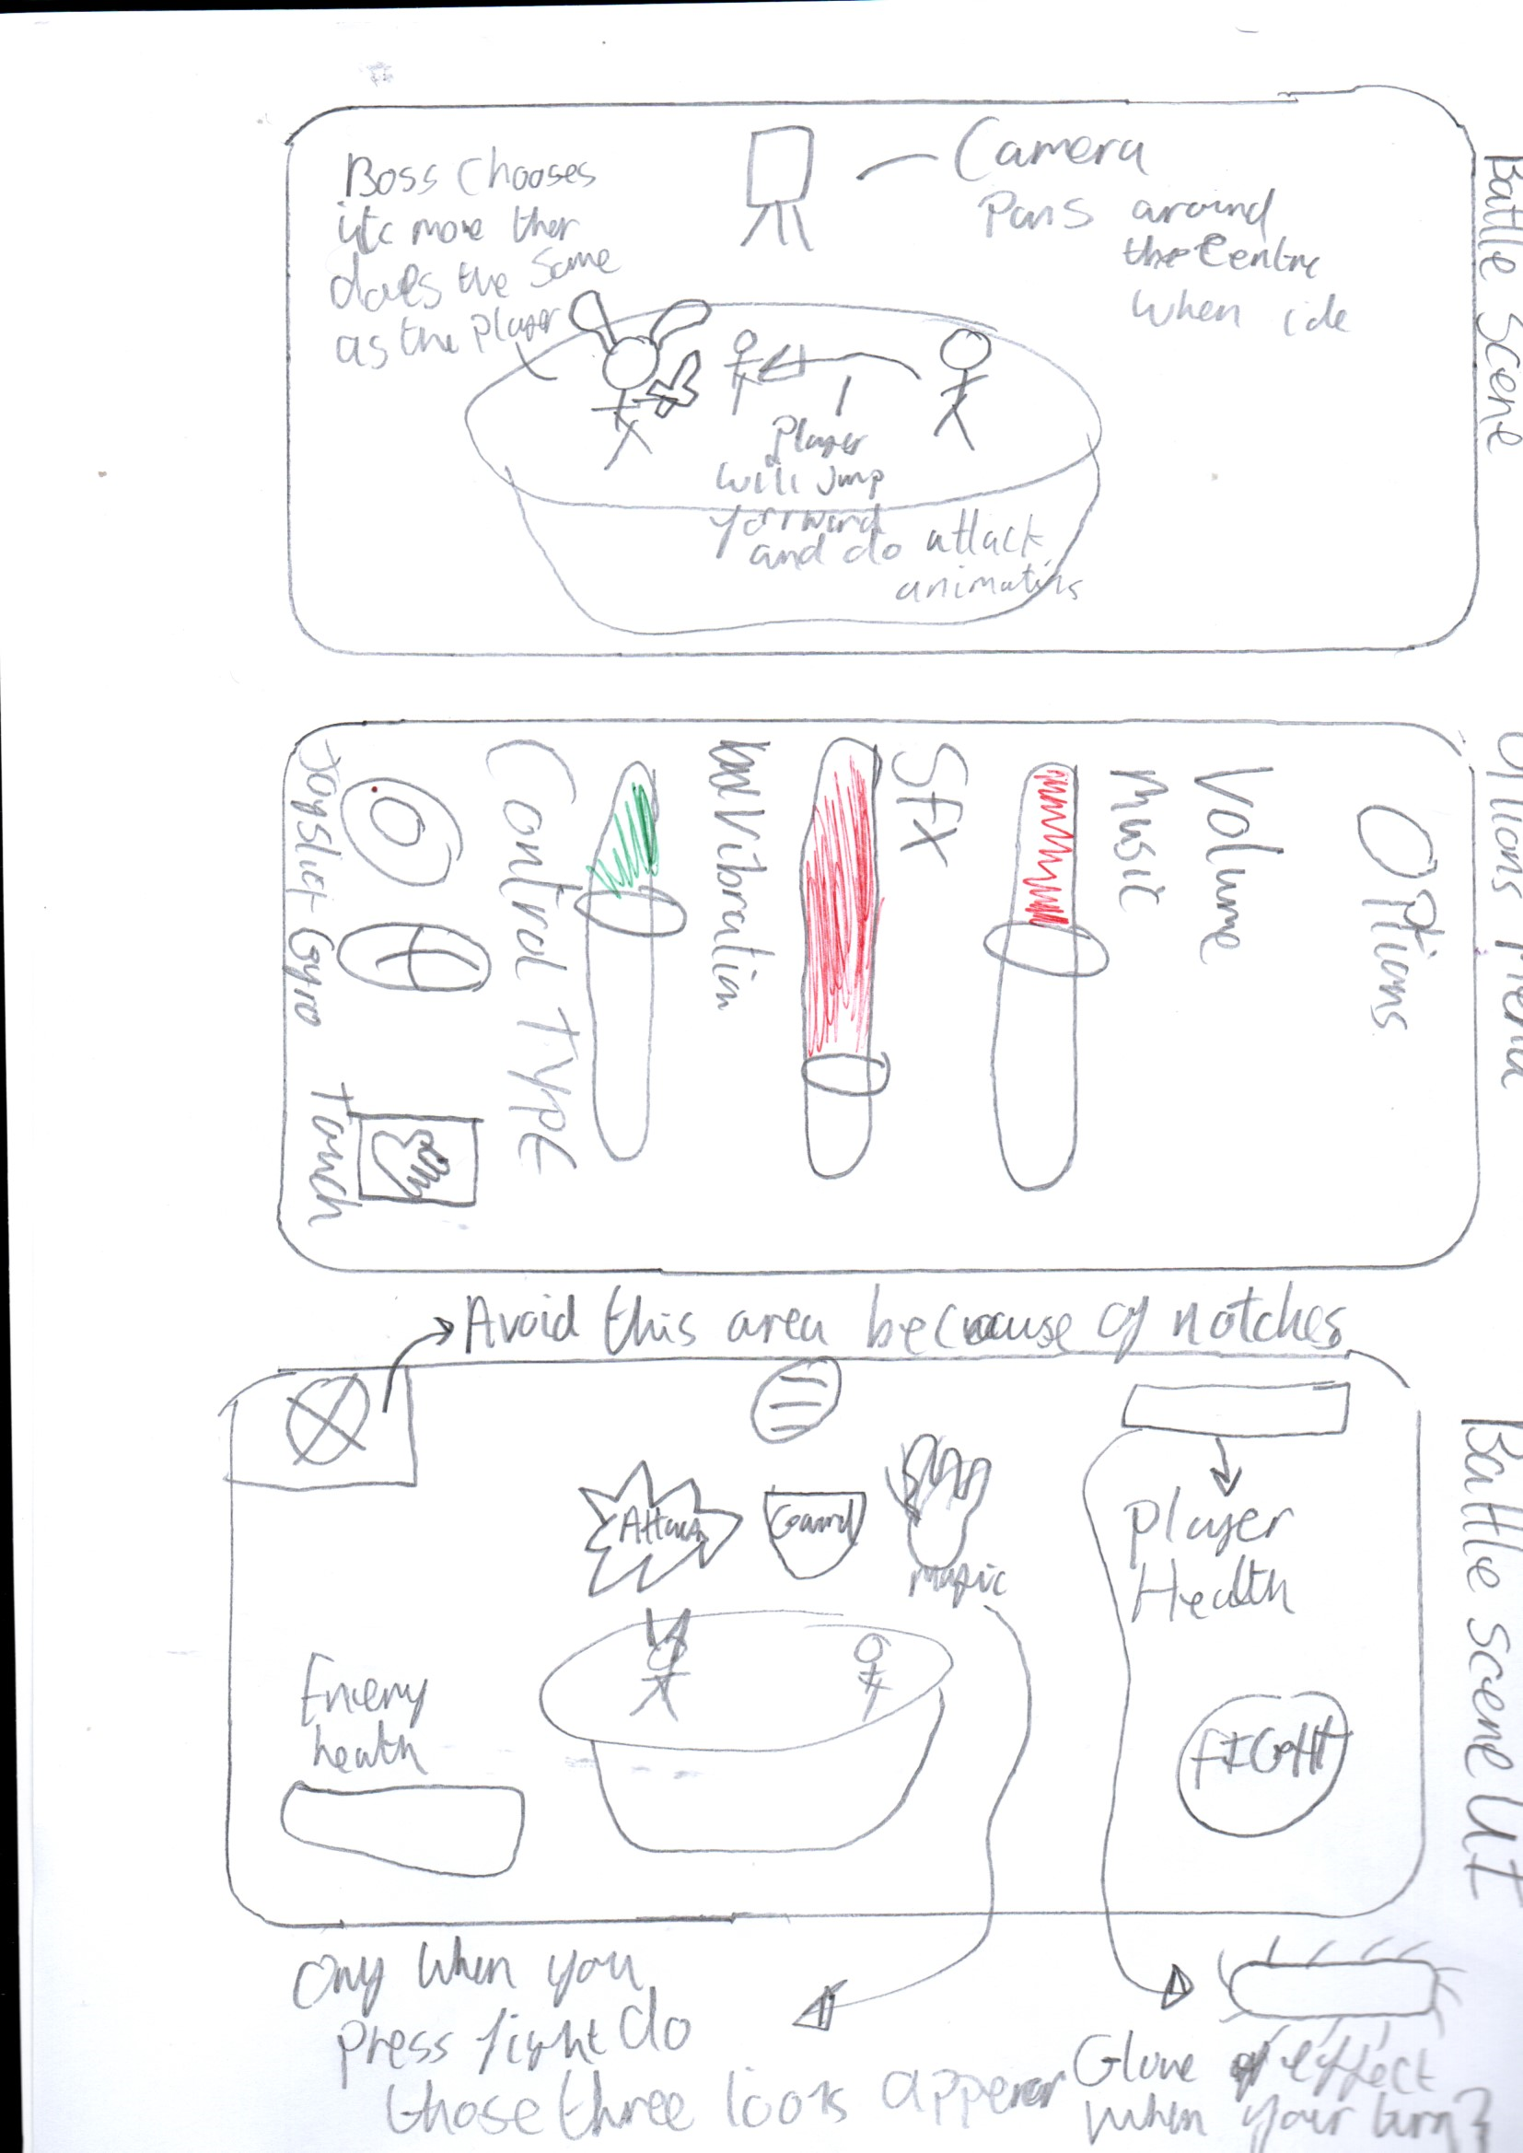
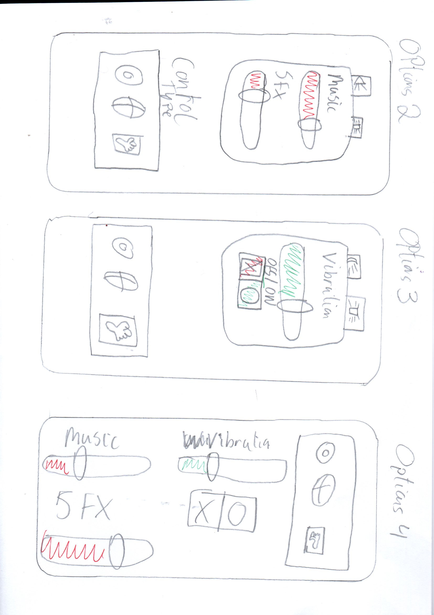
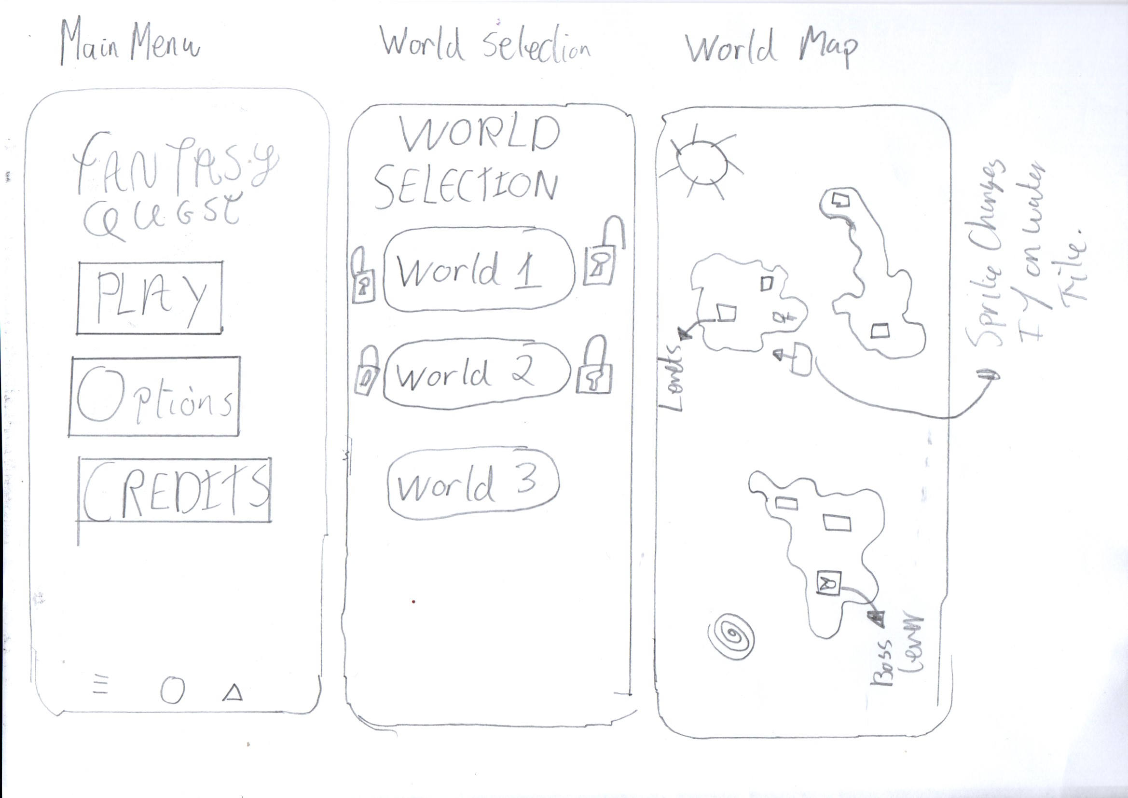
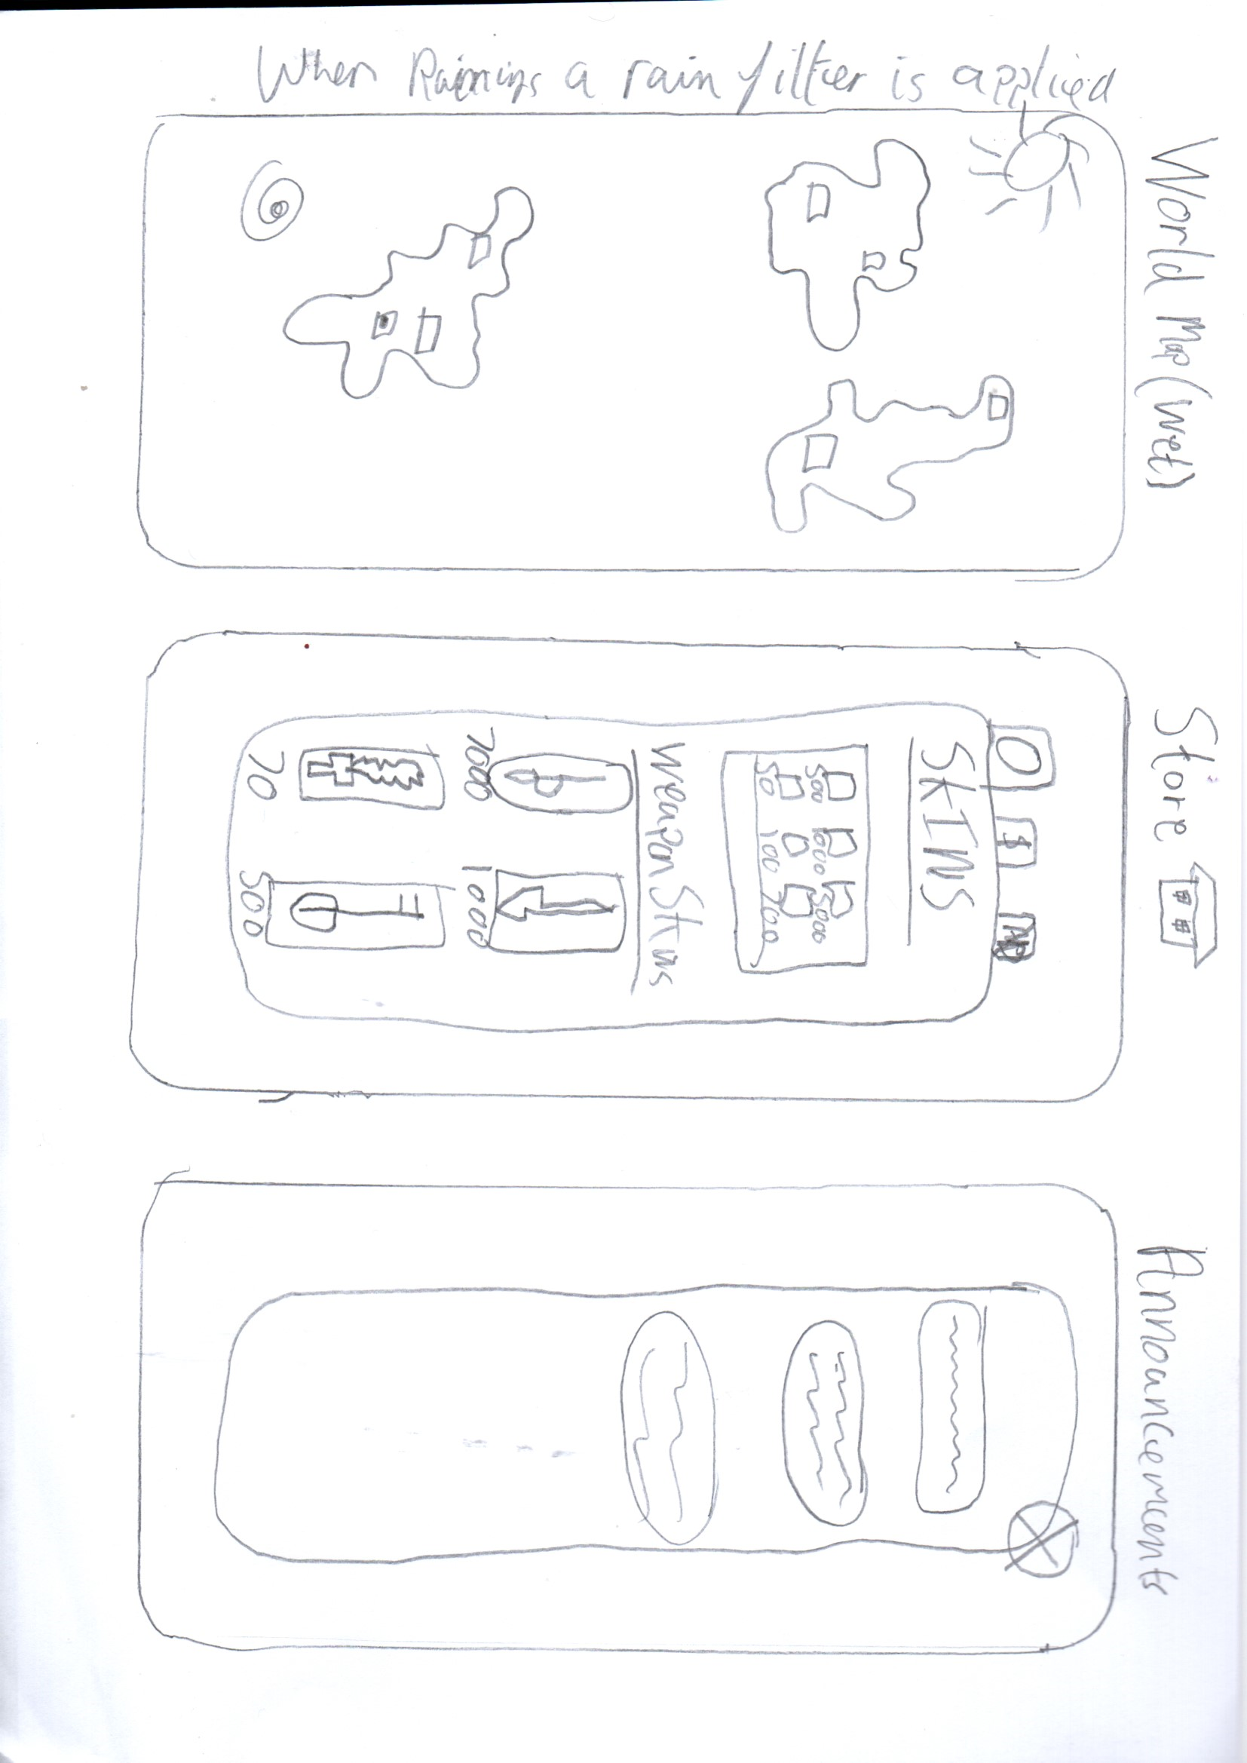
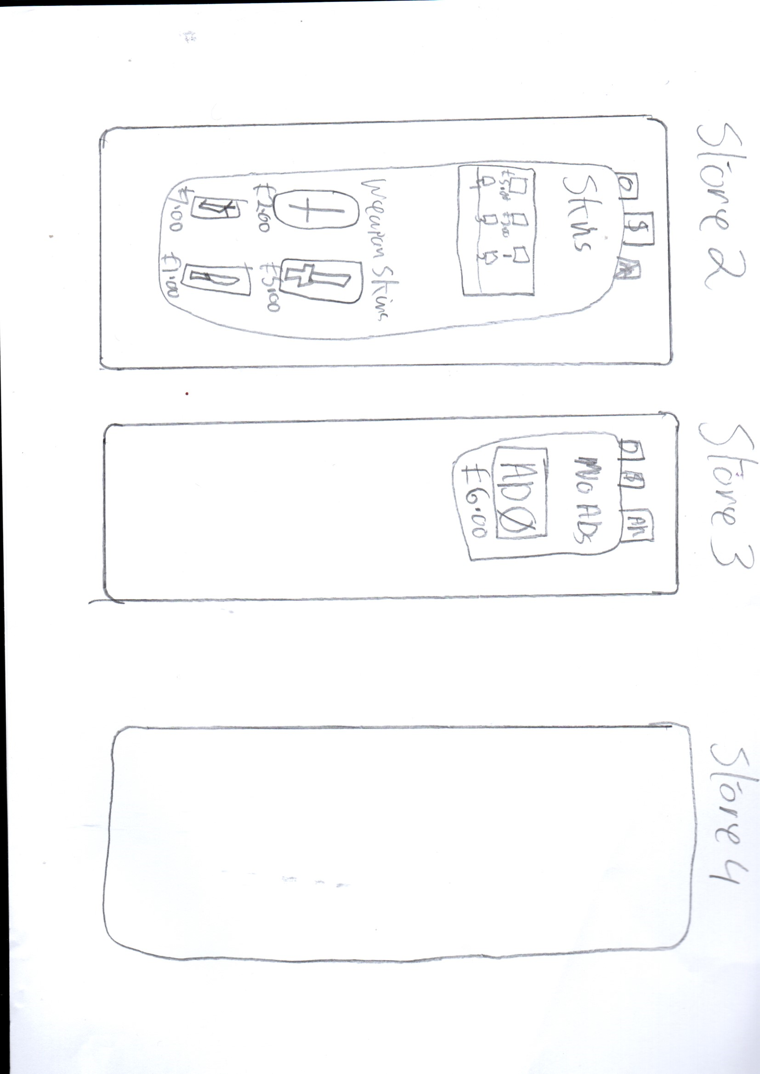
UI Drafts

Slide 12

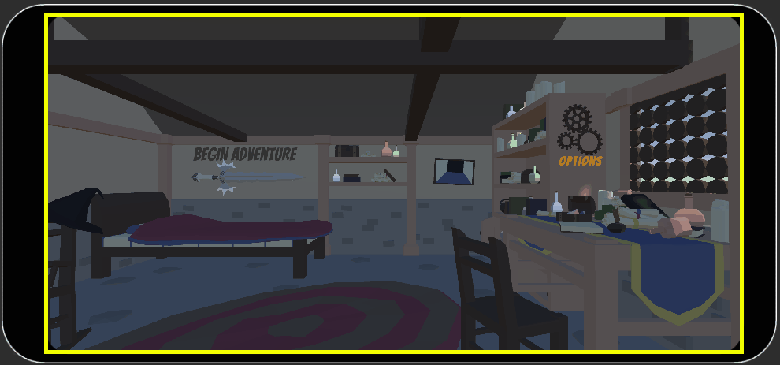
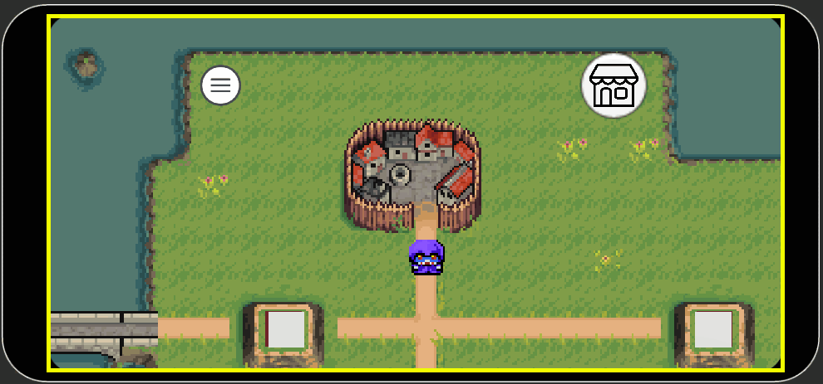
Current UI Implementation
Splash Screen
Main Menu
Options Menu
Battle UI
World Map

Slide 13

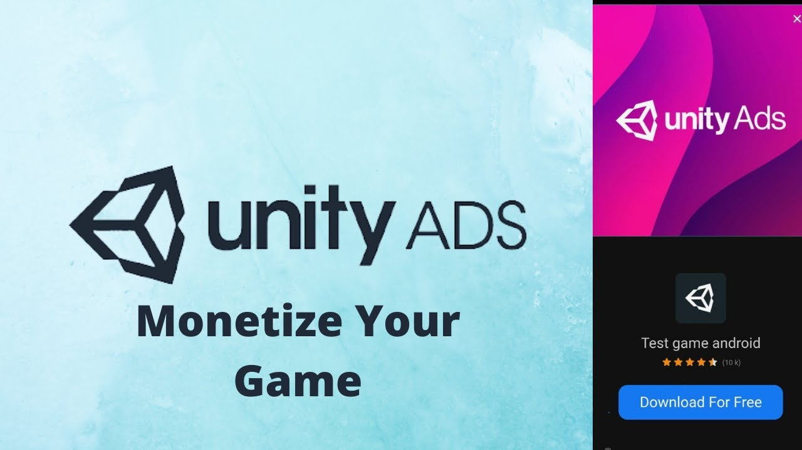


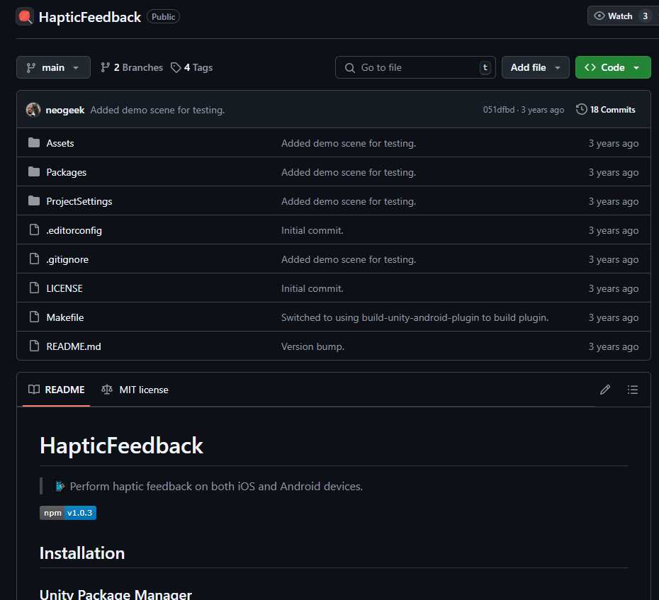
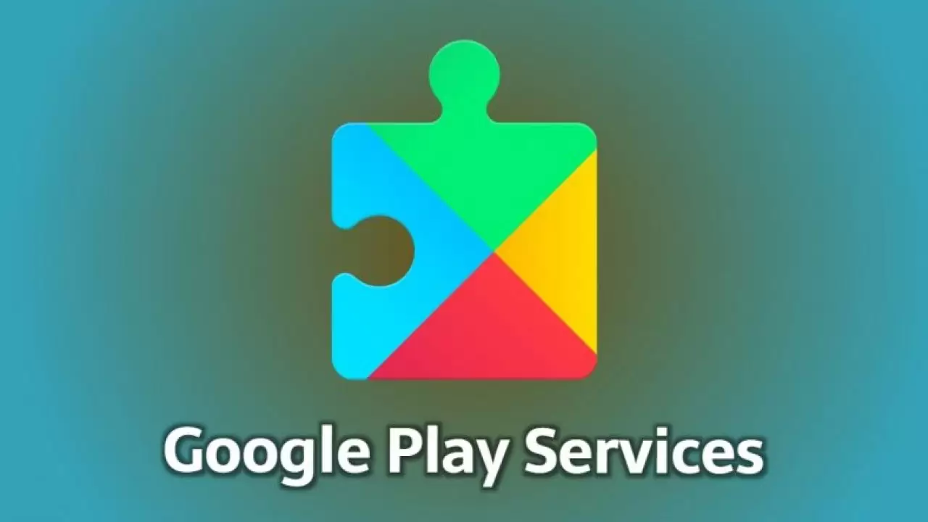

Features/API Integration To Come
Cinemachine
Unity Monetization
Weather API
Cinemachine package used to create a more dynamic camera when player is idle
Unity Monetization to implement ad breaks after completing a set number of levels
The tilemap will change from sunny to rainy depending on the real-life weather
Camera API
Candy Coded/Other Vibration APIs
Google Play Services
Players can take a picture of themselves or upload one as a profile picture for their save file
CandyCoded is a vibration API that is compatible with both Android and IOS and can set different vibration intensitys
Google Play can provide leaderboards and achievements which could be integrated into the game
Notes:
Cinemachine Camera System
Unity Monetization
Weather API
Camera API
Candy Coded/Other Vibration APIs
Google Play Services (Android Exclusive)

Slide 14
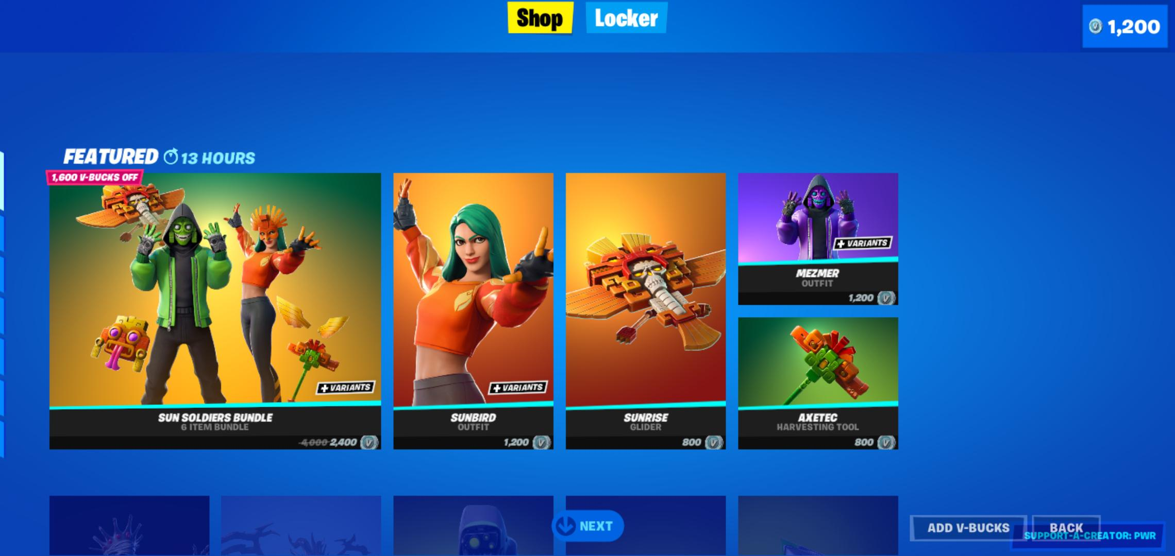
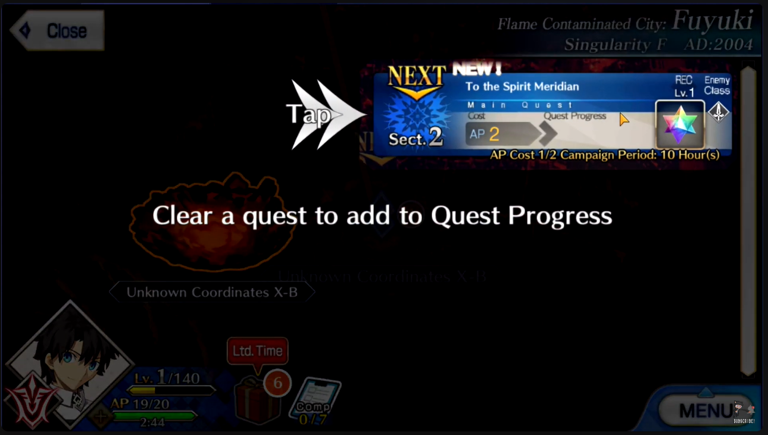
Market Research (Part 2 Monetization)
Statistics and Strategies
In App Purchases – A lot of games typically make use of a virtual exclusive currency purchased with real money to divorce the financial impact of making purchases for the player. For example £10 in real money can equate to a 1000 in game gold.
In App Advertisements – Very common in free to play games. Typically, an ad will play after a set number of activities have been completed (think when you complete a few levels in a game or 30 minutes after listening to Spotify)
Artificial Roadblocks – Sometimes certain games add in real world-based timers to stall your progress such as clash of clans build times to increase incentive to buy in ap purchases. FGO uses this by giving you an AP bar you must expunge to play levels affectively limiting your playtime

Slide 15
Market Research (Part 2 Monetization)
Personal Perspective
Typically enjoy free to play games that have little amounts of intrusive ads
Play to win elements are off putting if overtly in your face
In game currencies over time have lost the illusion for me personally and now I have become more and more weary of spending money
Games that limit my play time artificially are rather annoying and I would quickly lose interest in coming back only to have my progress halted

Slide 16
Cross Platform Integration
While the game is primarily being developed with Android in mind and leaderboards and achievement being envisioned through utilising the google play services it can be transitioned into having the leaderboards and achievements built into the game itself rather than being hosted by an external service
Utlising vibrations across platforms is interesting. While using the standard vibration functions only android allows the length of vibrations to be altered a external package like CandyCoded can be implemented that is platform agnostic

Slide 17
Demo Time

Slide 18
Limitations
While the UI can scale appropriate to the target platforms it doesn’t look very appealing
Turn Based system is currently very Janky and lacks full AI integration (Unreal Engine)
Battles currently are not very exciting. Additional mechanics will be added to spice things up

Slide 19
Credits
2D Assets
Board Tiles Fantasy 64x64 | OpenGameArt.org
Models From Sketchfab and Mixamo
Newsfeed – Sketchfab
Mixamo
Animations From Mixamo
Mixamo
Icons
Menu Icons & Symbols

Slide 20
Thank you

